Slide 1



Revenue Insights - Hospitality Domain
View in Power BI
Last data refresh:
12/22/2023 10:43:53 PM UTC
Downloaded at:
12/22/2023 10:45:06 PM UTC

Slide 2
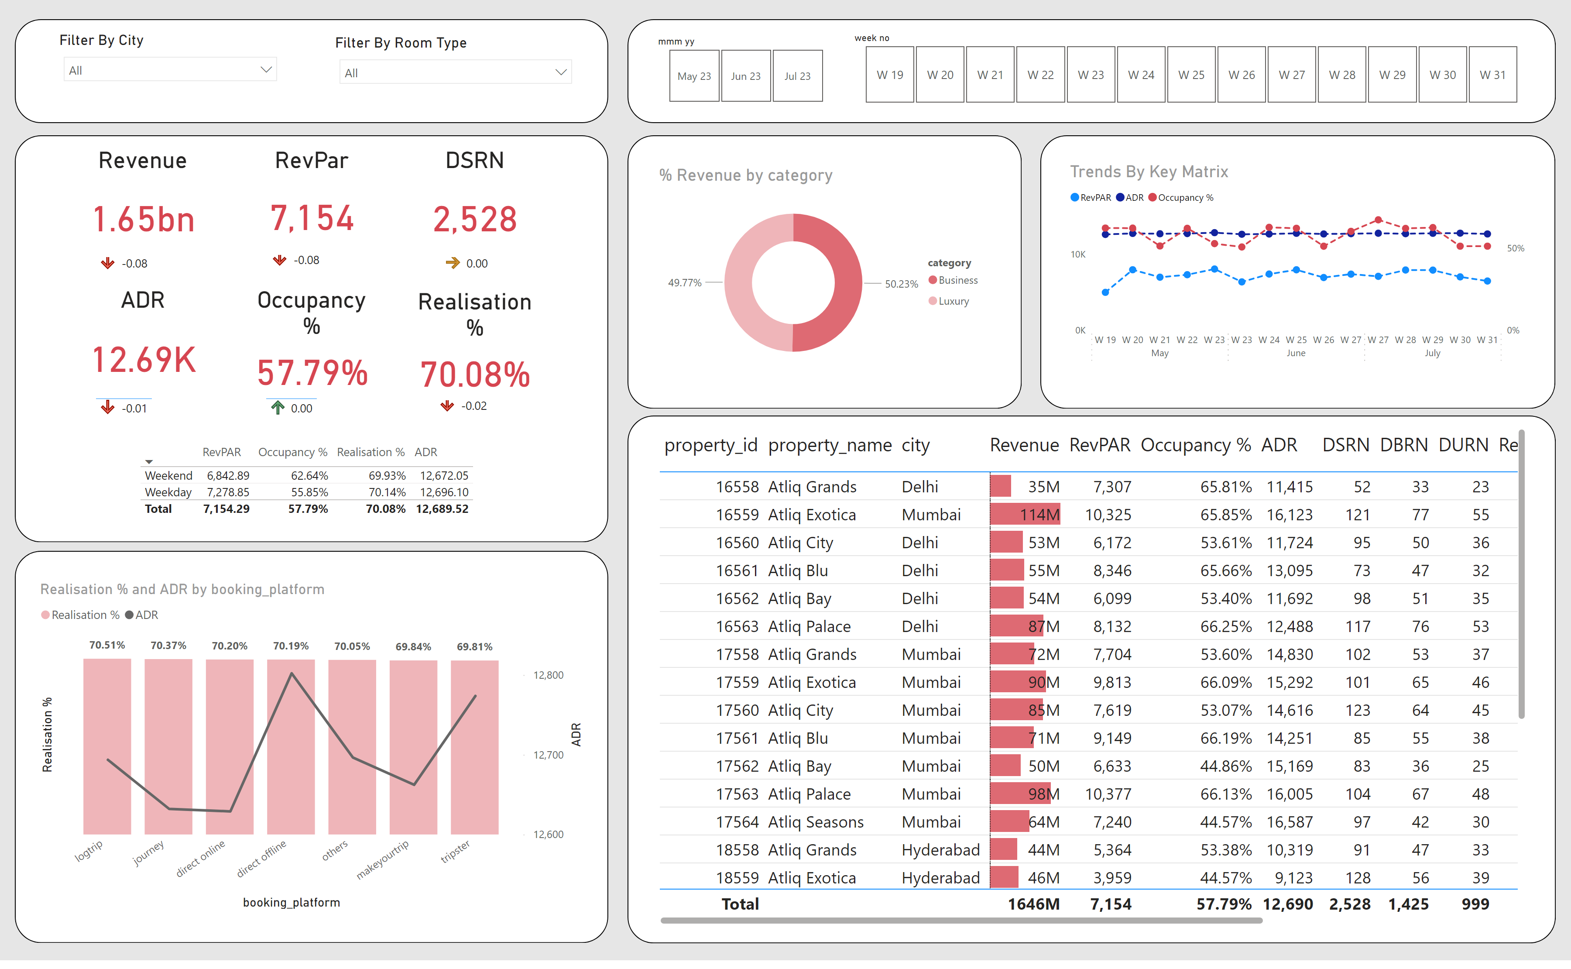
Page 1
Notes:
Revenue
No alt text provided
tableEx
No alt text provided
% Revenue by category
No alt text provided
RevPar
No alt text provided
DSRN
No alt text provided
Occupancy %
No alt text provided
ADR
No alt text provided
Realisation %
No alt text provided
Trends By Key Matrix
No alt text provided
tableEx
No alt text provided
tableEx
No alt text provided
tableEx
No alt text provided
tableEx
No alt text provided
lineStackedColumnComboChart
No alt text provided
tableEx
No alt text provided
shape
No alt text provided
shape
No alt text provided
shape
No alt text provided
shape
No alt text provided
shape
No alt text provided
shape
No alt text provided
shape
No alt text provided
tableEx
No alt text provided
tableEx
No alt text provided
Filter By City
No alt text provided
Filter By Room Type
No alt text provided
slicer
No alt text provided
slicer
No alt text provided

Slide 3
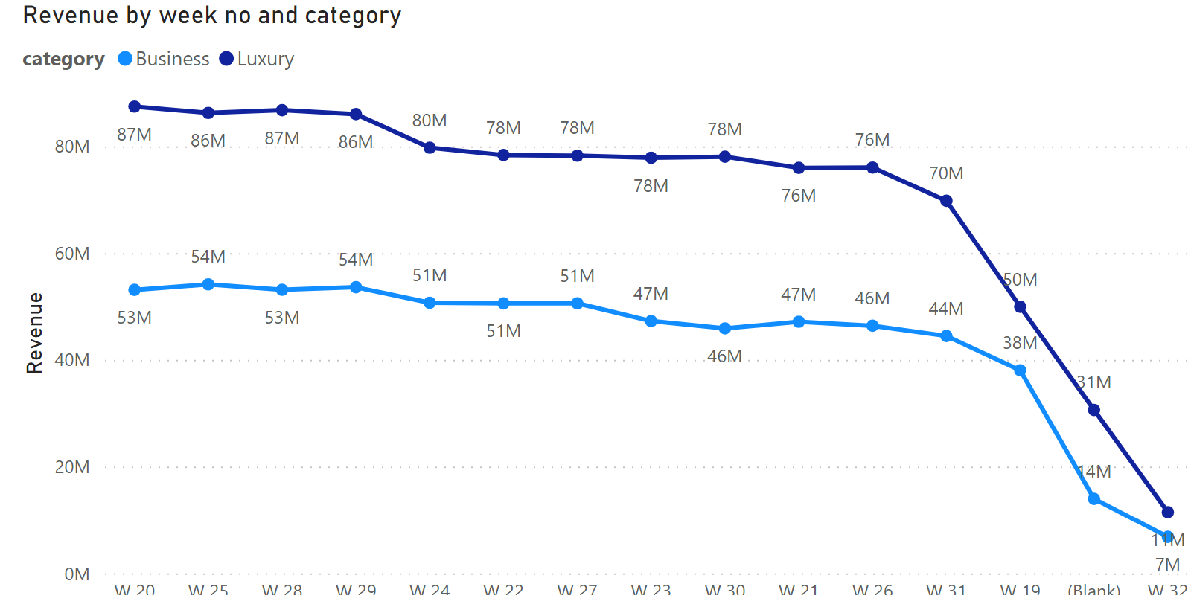
Page 2
Notes:
lineChart
No alt text provided

